Slide 1
Puerto Rico Virtual: Education & Development
Pablo Rodríguez, MBA-TM
Executive Vice President

Slide 2
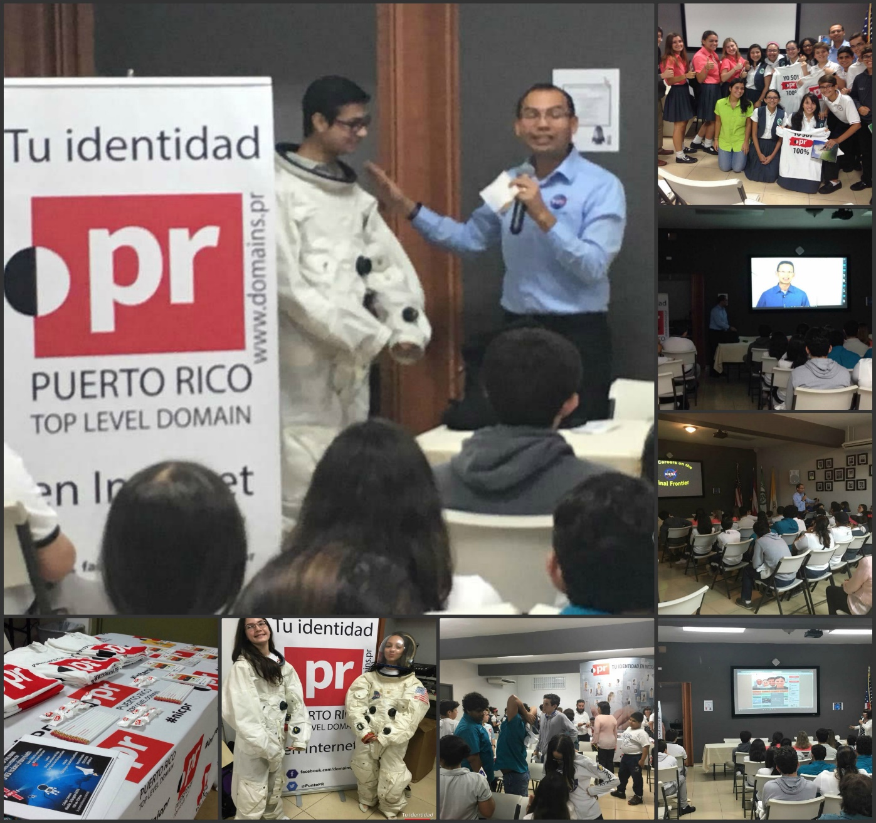
The sky is no longer the limit…

Slide 3
Collaborating with NASA – Promoting STEM among our youth

Slide 4
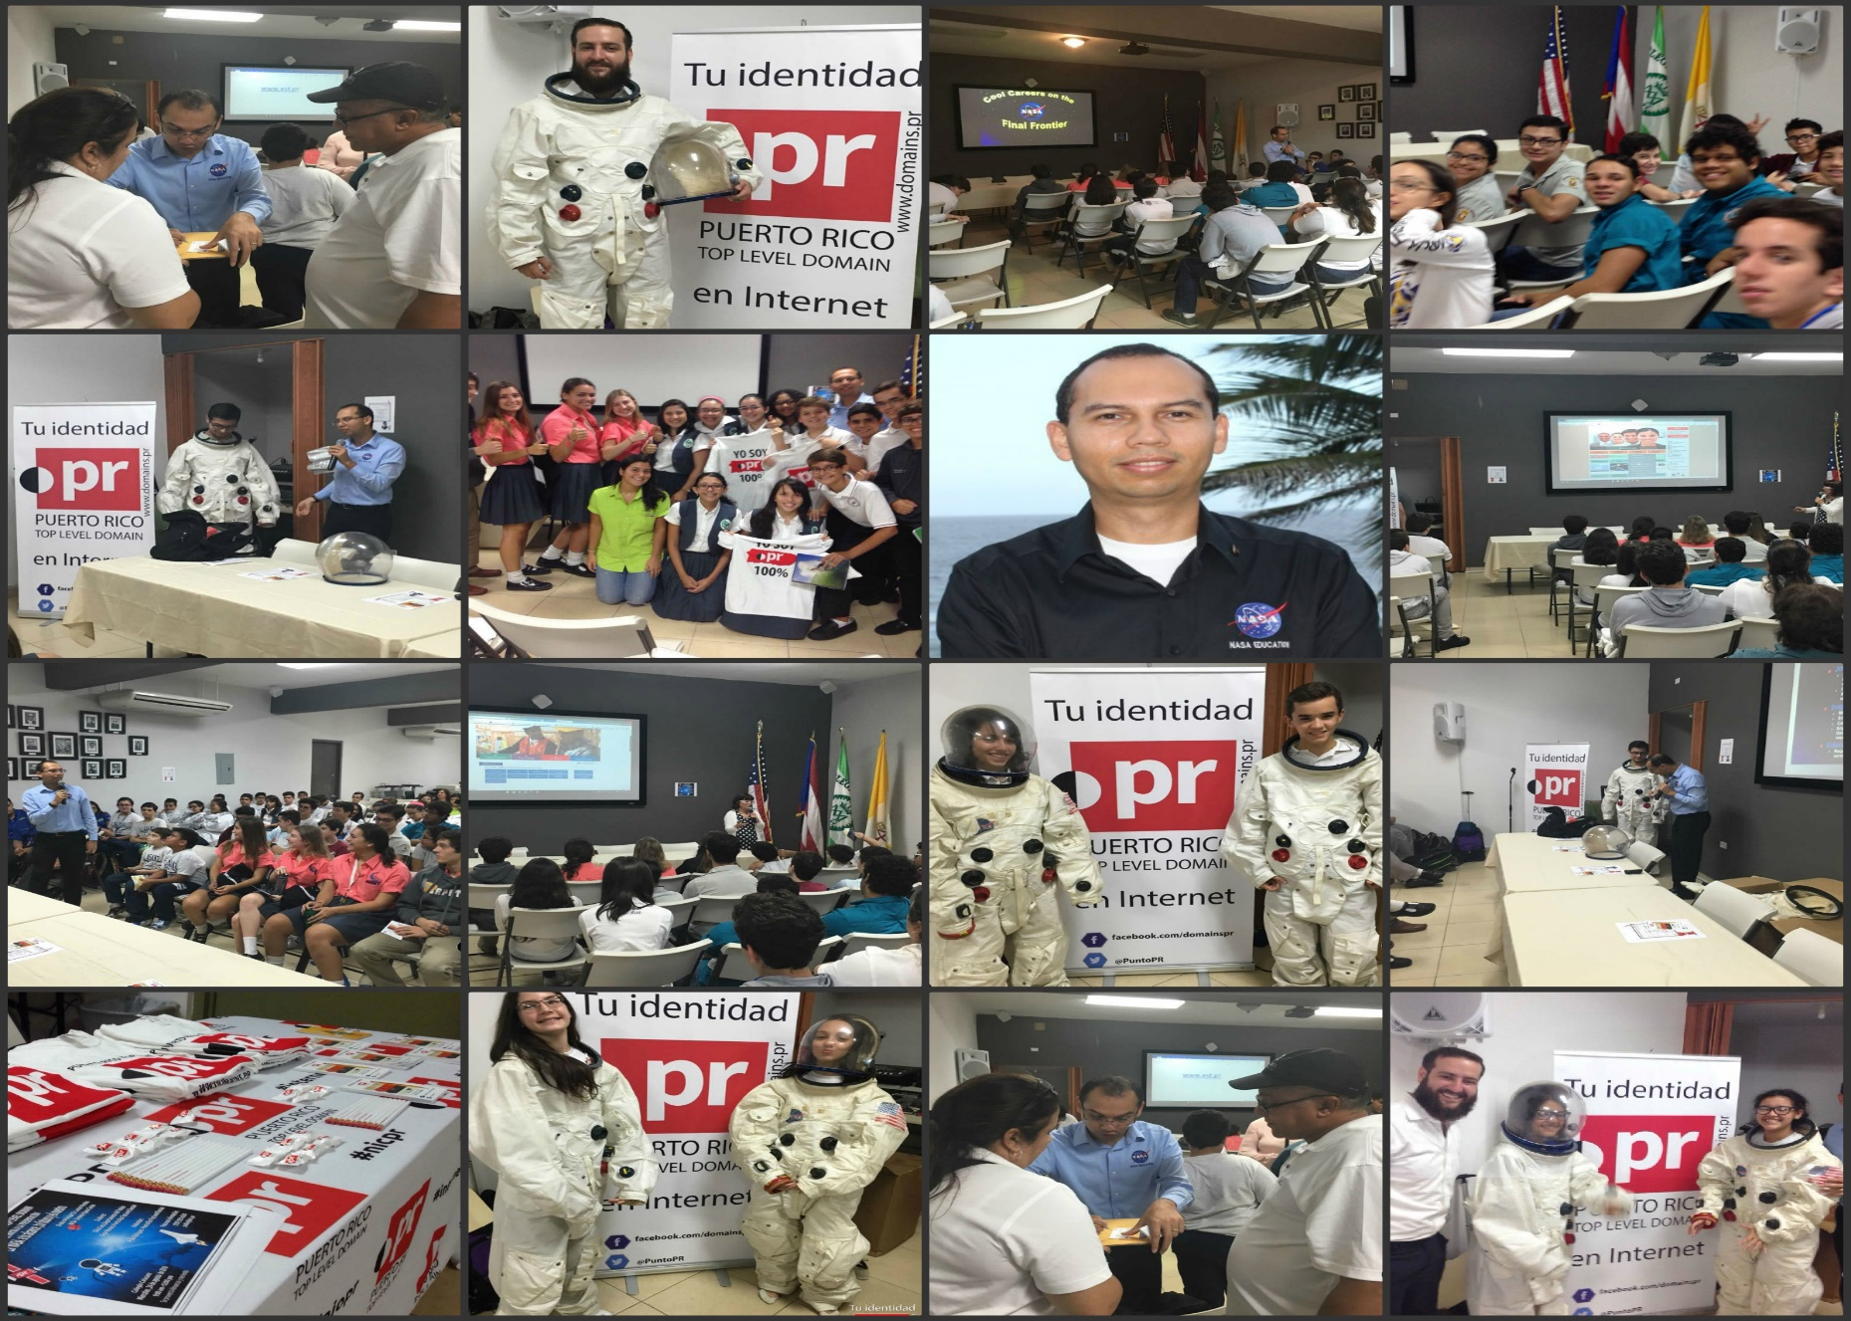
NASA – Space exploration – Our Youth

Slide 5
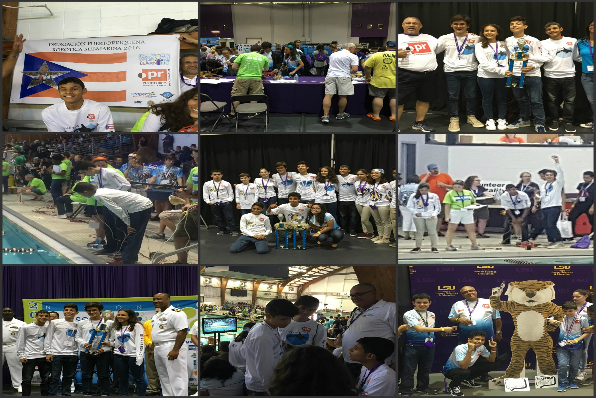
Submarine Robotics – 2016 Champions Submarine Robotics competition

Slide 6
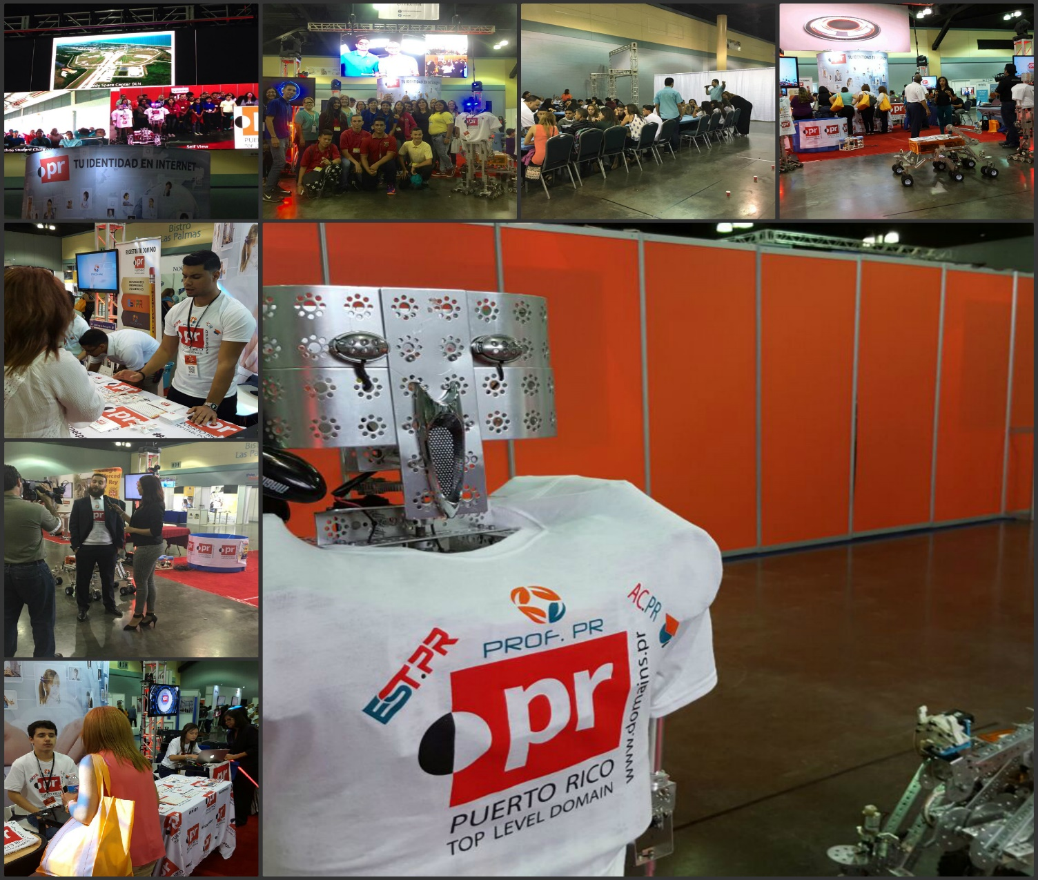
Supporting students, teachers, and academia

Slide 7
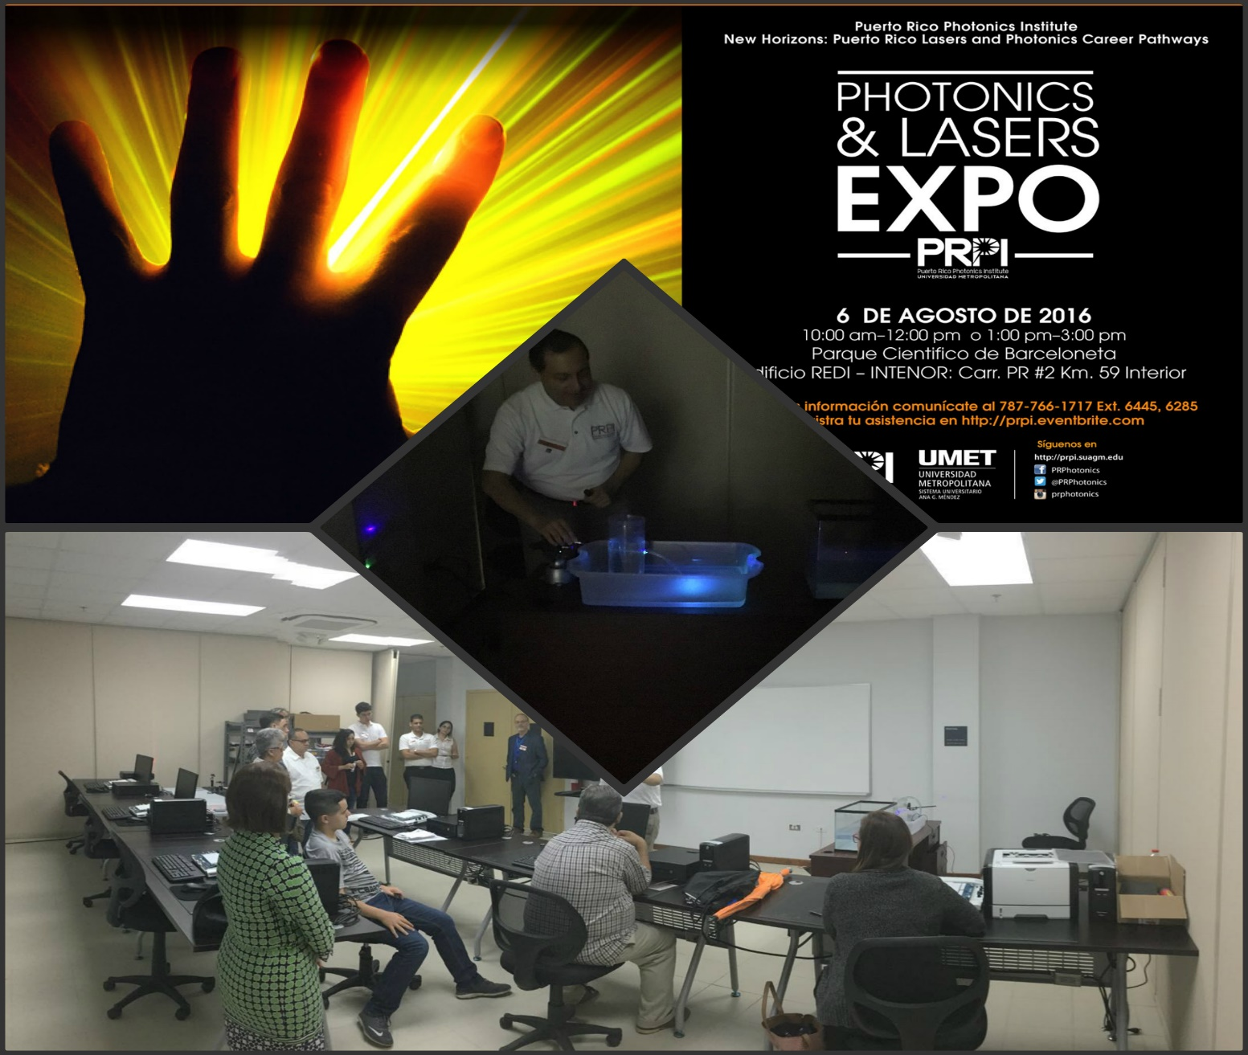
Harnessing the power of light

Slide 8
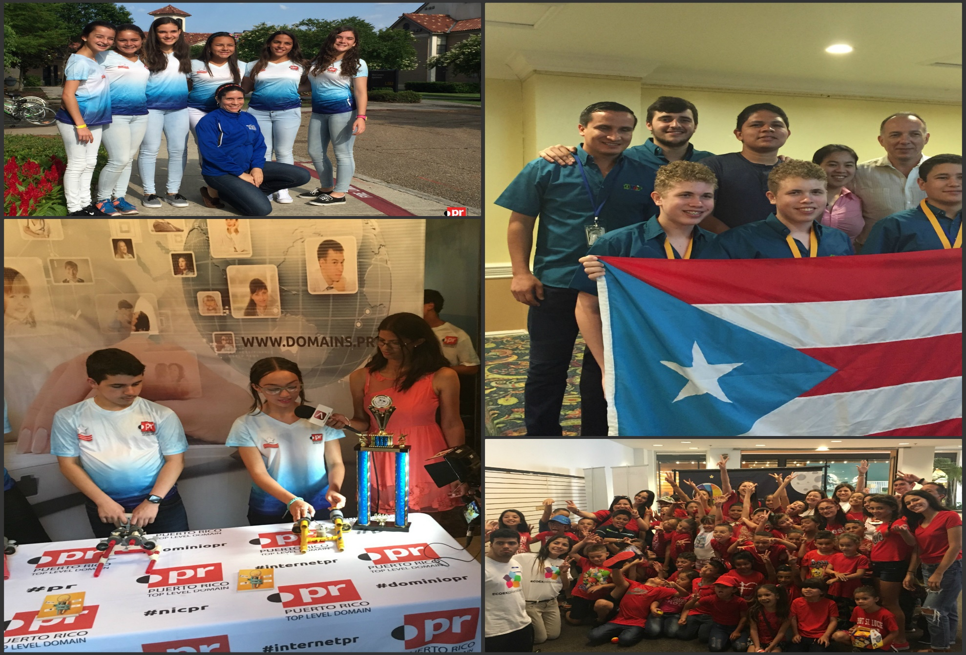
Our Champions – Science Technology Engineering Mathematics (STEM)

Slide 9
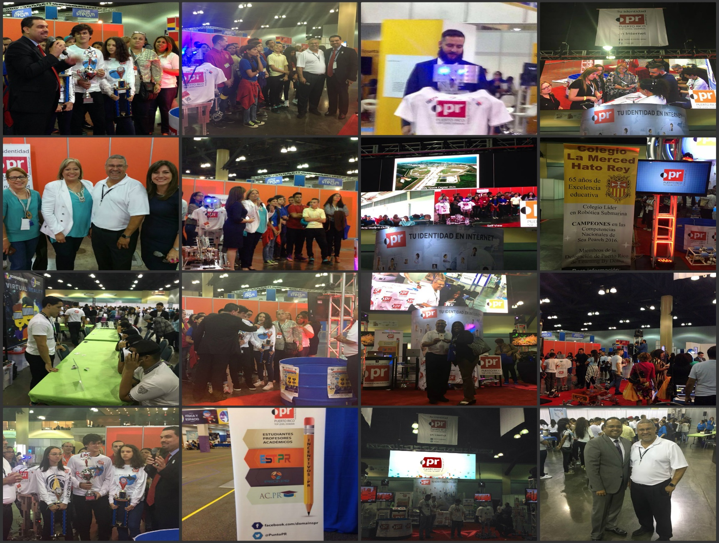
Collaborating with Government Agencies – Education & Telecommunications

Slide 10
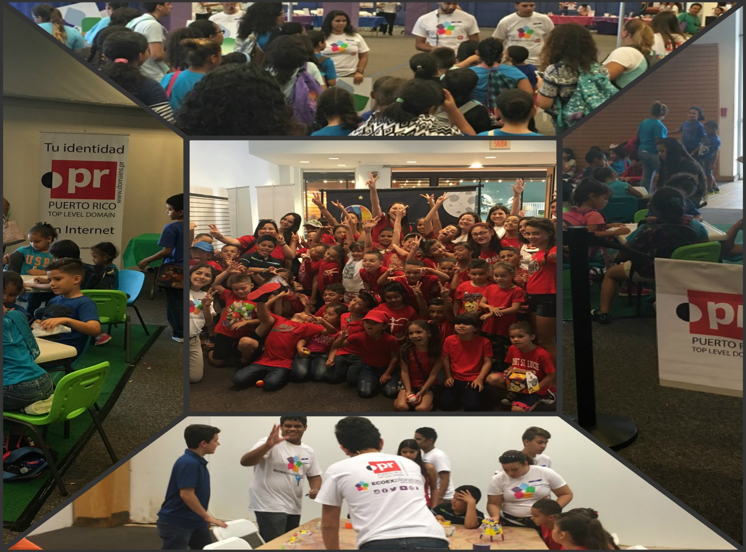
Developing new generations

Slide 11
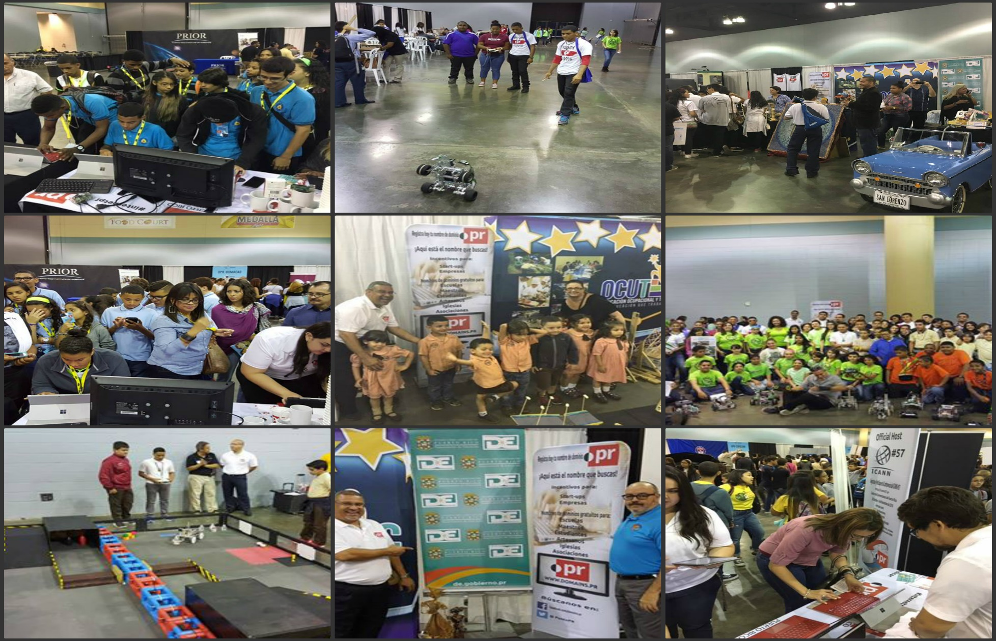
Developing new generations

Slide 12
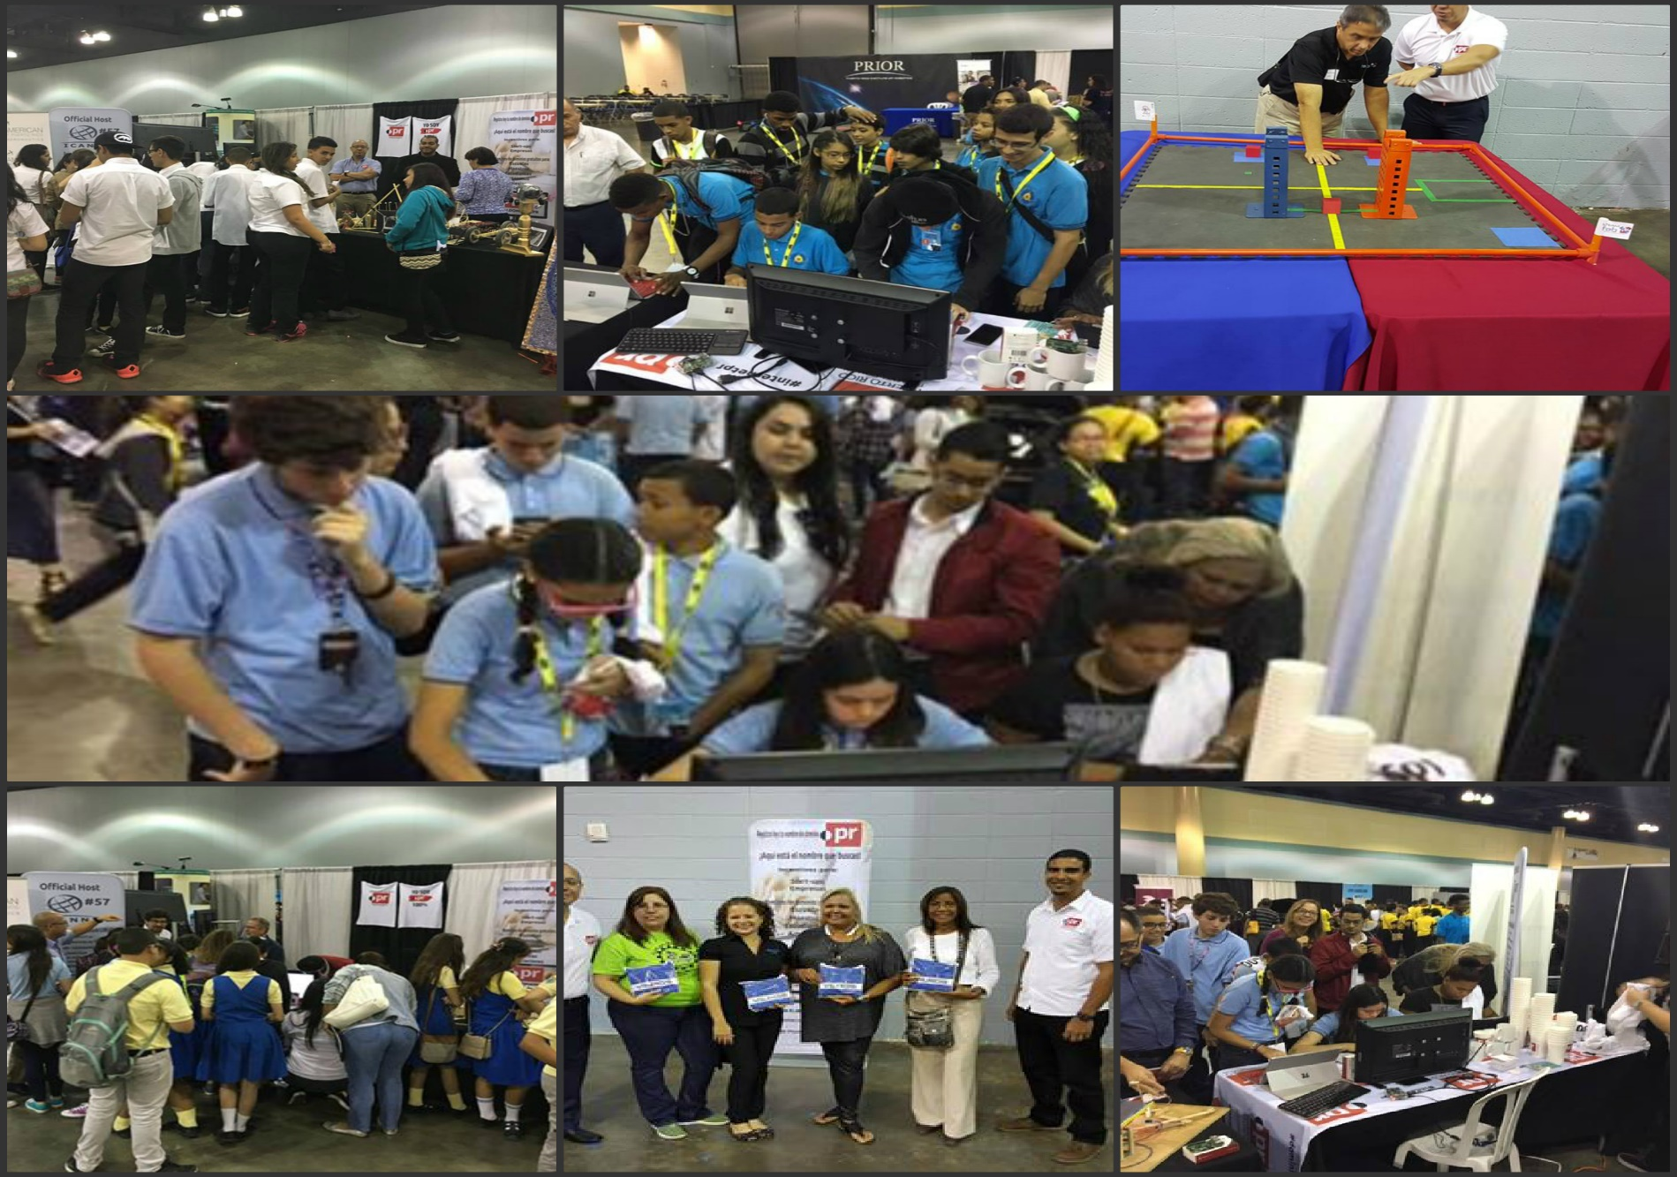
Paving the way for future generations

Slide 13
Involved with our community’s social issues

Slide 14
Remaining relevant

Slide 15
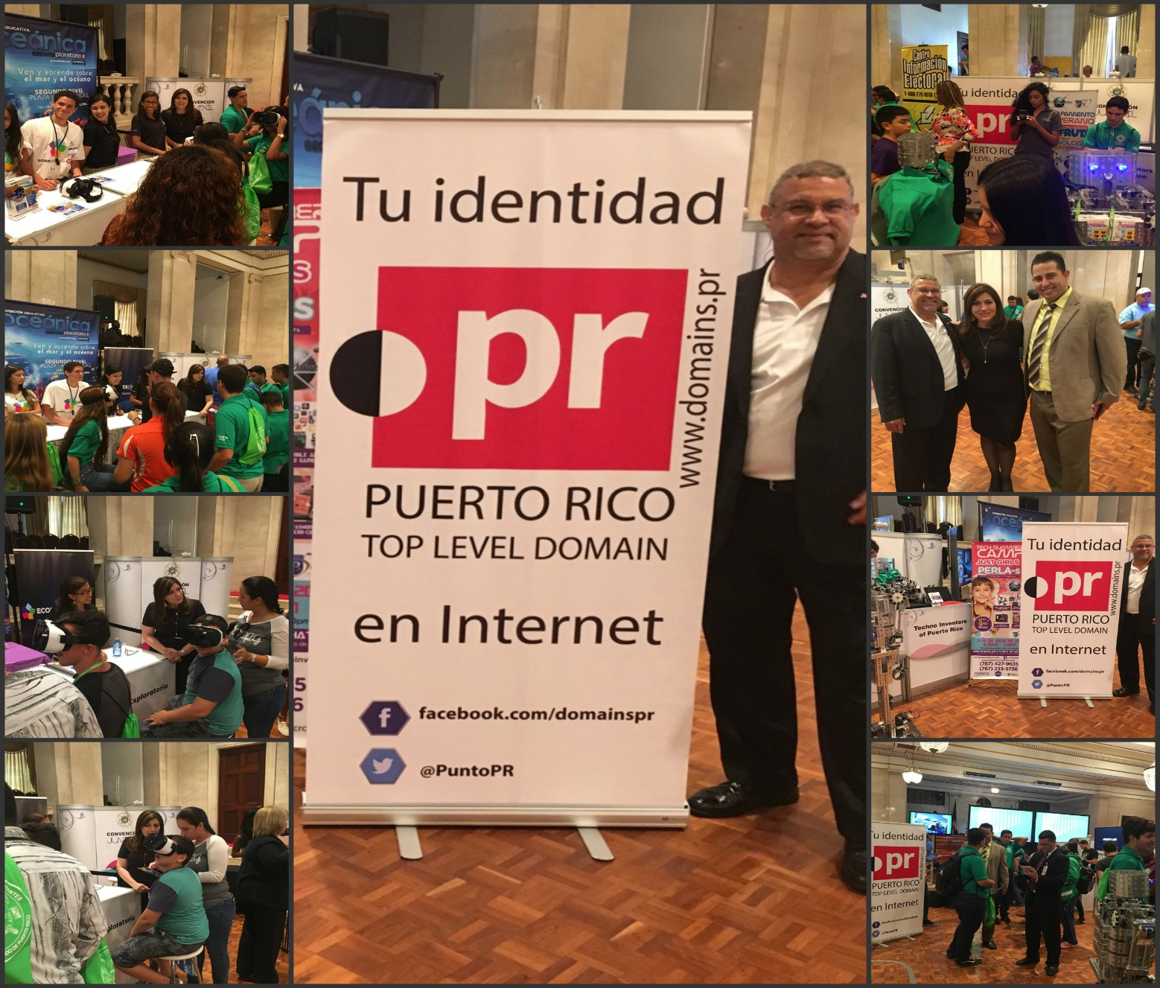
Remaining relevant

Slide 16
Contact information
Pablo Rodríguez
Executive Vice President
Office: 787.753.5869
Mobile: 787-425-1517
Email: pablo@nic.pr
Skype: pablo.nic.pr

