Slide 1
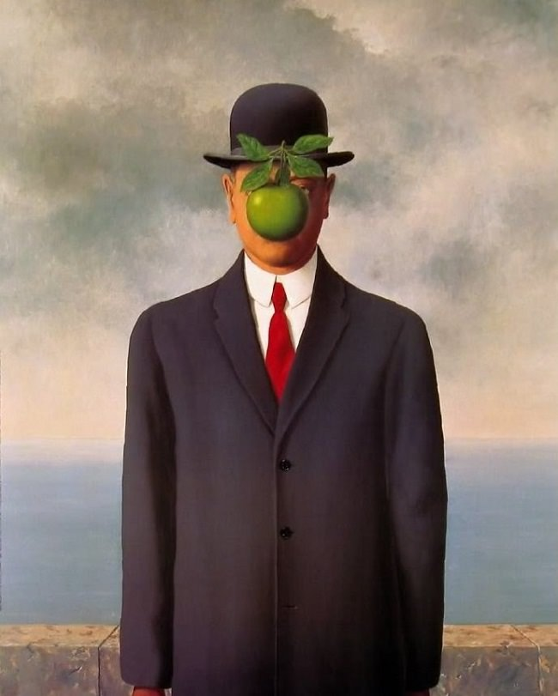
PTI Board
ccNSO meeting 6th November 2016
ICANN 57

Slide 2
Background for PTI Board
Board composition
The way forward

Slide 3
Background Public Technical Identifiers Board
Part of the new set up – the legal separation
Board of 5 directors and have the minimum statutorily required responsibilities and powers - all appointed by ICANN as the sole member of PTI.
The PTI Board is comprised of :
three directors who are employed by ICANN and PTI and
two additional independent directors (Nominated by NomCom)

Slide 4
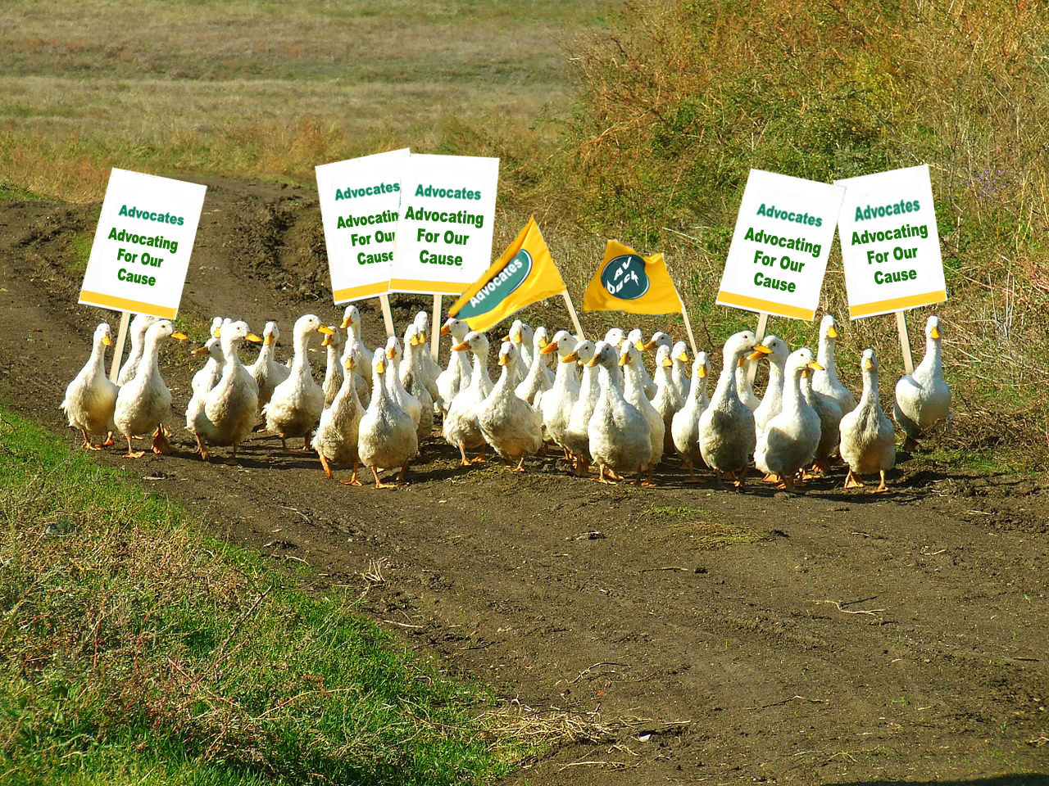
PTI Board for the next year
The PTI Board:
Elise Gerich, President PTI
David Conrad, CTO ICANN
Akram Atallah, President Global Domains Division ICANN
Jonathan Robison, independent director
Lise Fuhr, independent director

Slide 5
The way forward
The PTI Board independent directors are interim – give time for the NomCom to set up requirements
Need to ensure transparency and visibility of the work of the PTI Board for the community
Need to ensure communication between CSC and PTI Board

Slide 6
The work has just begun……

