Slide 1
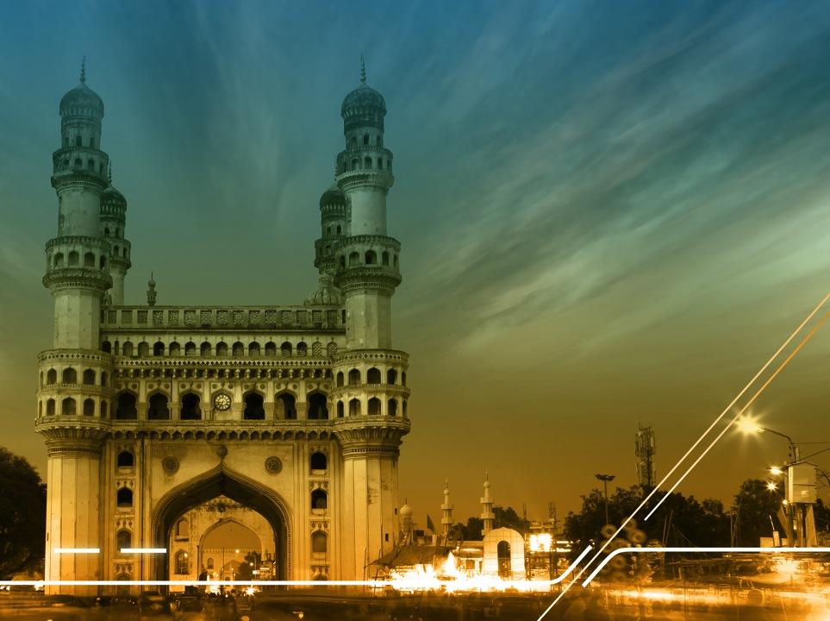
Members Meeting Highlights
Alejandra Reynoso (.gt)
Nov. 6th & 7th, 2016

Slide 2
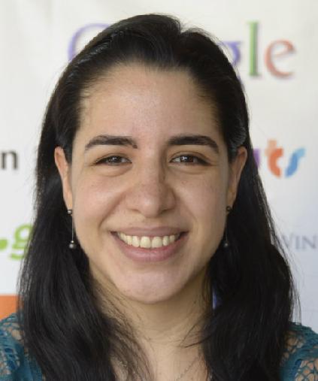
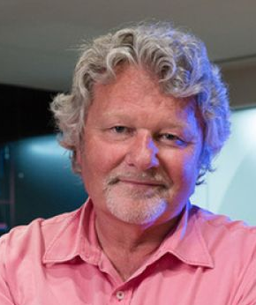
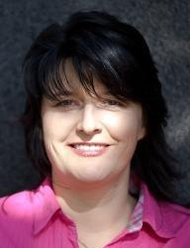
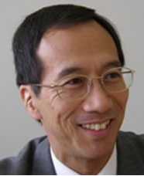
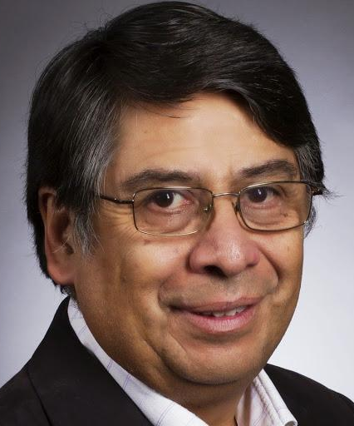
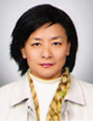
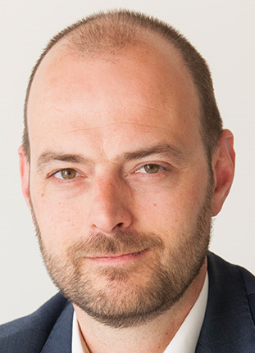
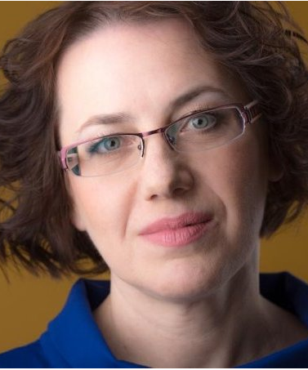
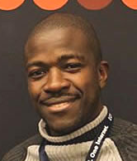
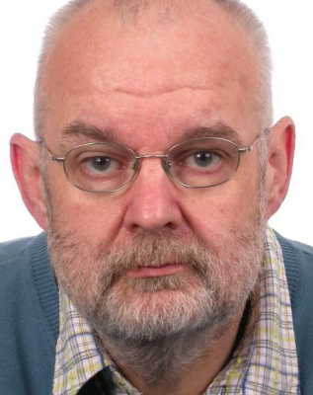
ccNSO Meetings Programme WG
Alejandra .gt
Allan .ca
Katrina .lv
Hiro .jp
Sanna .fi
Patricio .cl
Young-Eum .kr
Peter CENTR
Svitlana .ua
Barrack AFTLD
Ondrej .cz (observer)
Eberhard .na (observer)

Slide 3
ccNSO Secretariat
Kimberly Carlson
Bart Boswinkel
Joke
Braeken

Slide 4
First C meeting format
Annual General Meeting

Slide 5
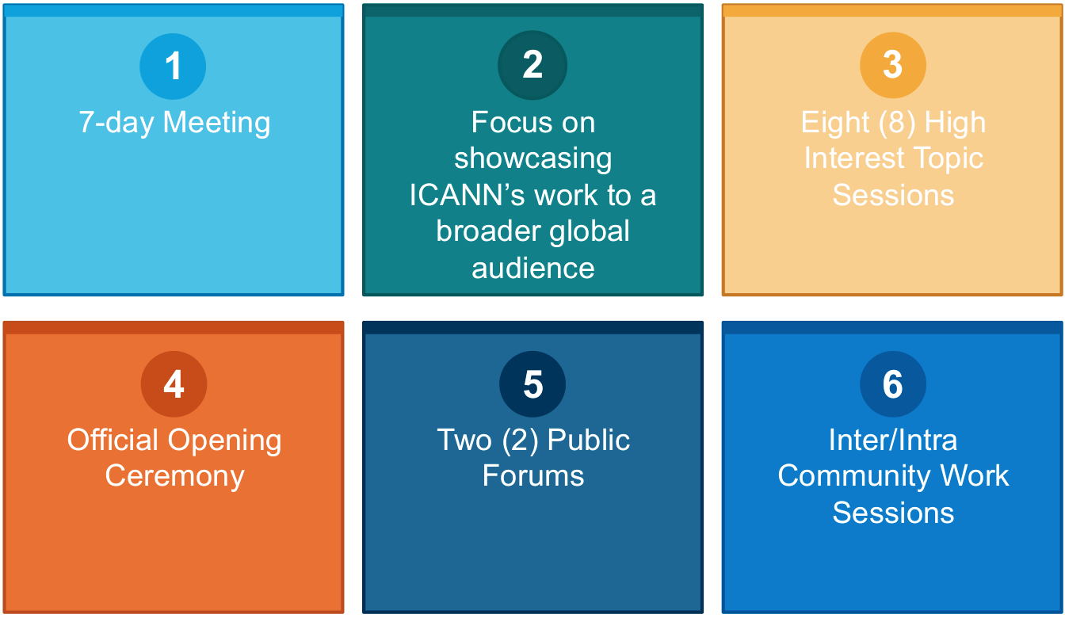
Meeting Format - Annual General Meeting

Slide 6
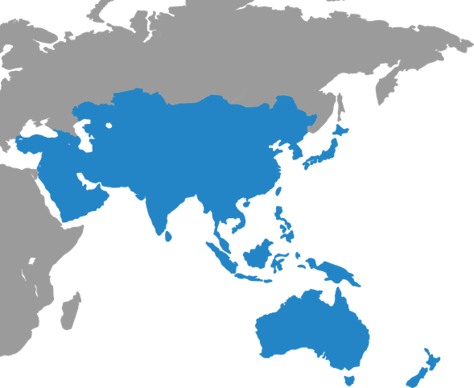
ccNSO Schedule : 4 days
1
2
FRIDAY
Working Group meetings
SATURDAY
Tech Day
Here’s a place to introduce your third agenda item from your talk.
3
4
SUNDAY
ccNSO Member Day 1
MONDAY
ccNSO Member Day 2
Here’s a place to introduce your sixth agenda item from your talk.
Notes:
This is a stylized agenda slide for your presentation.
To delete a box, if there are too many boxes, click the edge of the box, ensure the entire box is highlighted, then DELETE.
To update the numbers and text, click inside the circle for the numbers or in the box for the text, revise the text.

Slide 7
ccNSO Members Meeting Day 1

Slide 8
ccNSO Schedule : Sunday, November 6th
3
09:00-15:00 - Members Meeting Day #1
12:00-12:30 - Joint meeting with GAC
15:15-16:45
Q&A: ccNSO Council and ICANN Board nominees
15:15-16:45
HIT 4 - Exploring public interest within ICANN’s remit
17:00-18:30
HIT 5 - DNS and Content Regulation
Notes:
This is a stylized agenda slide for your presentation.
To delete a box, if there are too many boxes, click the edge of the box, ensure the entire box is highlighted, then DELETE.
To update the numbers and text, click inside the circle for the numbers or in the box for the text, revise the text.

Slide 9
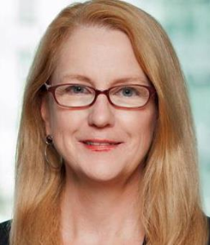
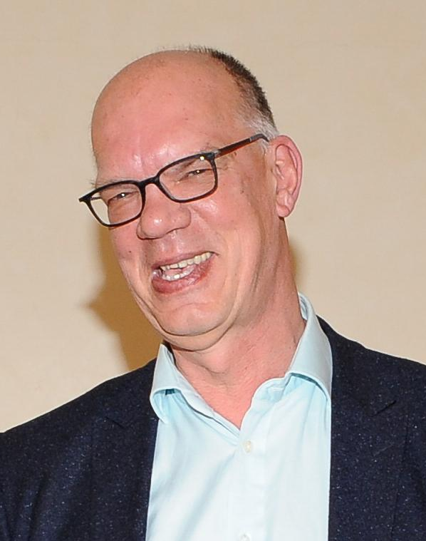
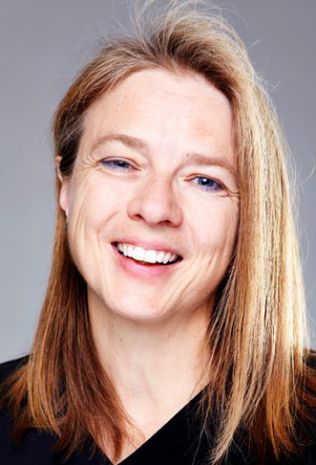
ccNSO Schedule : Sunday, November 6th
3
PDP: Retirement of ccTLD and Review Mechanism for the decisions on delegation, revocation and retirement of ccTLDs
Becky Burr
.us
Bart Boswinkel
ccNSO Secretariat
Chair
How does the IANA Stewardship implementation affect ccTLDs and what are the implications for the future?
Lise Fuhr
ETNO
Notes:
This is a stylized agenda slide for your presentation.
To delete a box, if there are too many boxes, click the edge of the box, ensure the entire box is highlighted, then DELETE.
To update the numbers and text, click inside the circle for the numbers or in the box for the text, revise the text.

Slide 10
ccNSO Schedule : Sunday, November 6th
3
Working Groups
Updates
ccTLD news
Session
Chair
Q&A: ccNSO Council and ICANN Board Nominees
Allan MacGillivray
.ca
Notes:
This is a stylized agenda slide for your presentation.
To delete a box, if there are too many boxes, click the edge of the box, ensure the entire box is highlighted, then DELETE.
To update the numbers and text, click inside the circle for the numbers or in the box for the text, revise the text.

Slide 11
#ccNSOcocktail - La Cantina poolside in Novotel
Many THANKS to our generous sponsors!
Sunday, November 6th
18:30 - 20:30 Don’t forget your printed invitation.
Shuttles leaving around 8:40 pm to ICANN57 hotels
http://foodrhythms.com/places/india/ap/hyderabad/novotel-la-cantina/484586
Notes:
If you could give an obvious shout out to Nixi – for organizing (they sponsored half, organized it locally and provided the invitations)
CIRA (.ca) helped make this happen
And .nz (Debbie) sponsored the after hour shuttles
Thank you!
Kim

Slide 12
ccNSO Members Meeting Day 2

Slide 13
ccNSO Schedule : Monday, November 7th
4
08:30-09:30
Joint meeting ICANN Board & ccNSO
09:30-15:00
Members Meeting Day #2
15:15-16:45
HIT 6 - Q&A ICANN General Counsel on legal advice
17:00-18:30
ccNSO Council meeting
17:00-18:30
HIT 7 - Underserved reg. ICANN
18:30-20:00
HIT 8 - Internet Governance - public session
Notes:
This is a stylized agenda slide for your presentation.
To delete a box, if there are too many boxes, click the edge of the box, ensure the entire box is highlighted, then DELETE.
To update the numbers and text, click inside the circle for the numbers or in the box for the text, revise the text.

Slide 14
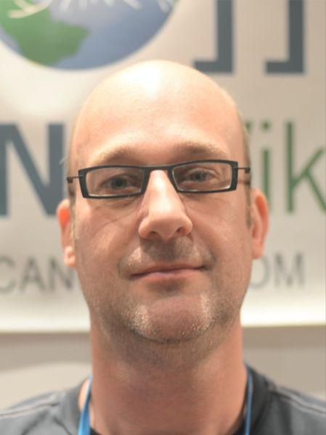
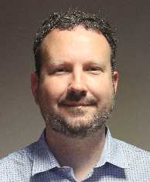
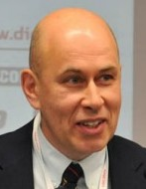
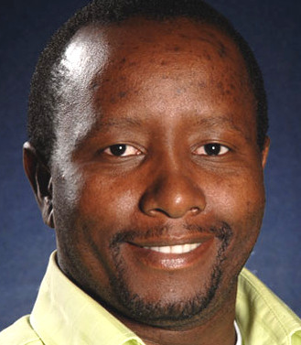
ccNSO Schedule : Monday, November 7th
4
Chair
Chair
Legal
Session
Update and next steps ICANN Accountability
Peter Vergote
.be
Jordan Carter
.nz
Chair
Chair
ROs
Update
Marketing
Session
Leonid Todorov
APTLD
Vika Mpisane
.za
Notes:
This is a stylized agenda slide for your presentation.
To delete a box, if there are too many boxes, click the edge of the box, ensure the entire box is highlighted, then DELETE.
To update the numbers and text, click inside the circle for the numbers or in the box for the text, revise the text.

Slide 15
ccNSO Schedule : Tuesday November 8th
08:30-10:30
Annual General Meeting
11:00-13:45
Public Forum II &
Community Recognition Program
Notes:
This is a stylized agenda slide for your presentation.
To delete a box, if there are too many boxes, click the edge of the box, ensure the entire box is highlighted, then DELETE.
To update the numbers and text, click inside the circle for the numbers or in the box for the text, revise the text.

Slide 16
Welcome to ccNSO!

