Slide 1
Guidelines Review Committee
Update
5-7 November 2016, Hyderabad

Slide 2
The Guidelines Review Committee has worked hard all summer...

Slide 3
Marrakech > Helsinki > Hyderabad
Document Type | Document Title
Guideline: | ccNSO Actions Respecting the Customer Standing Committee
Guideline: | ccNSO Actions Respecting the Root Zone Evaluation Review Committee
Guideline: | ccNSO Nominations to Specific Review Teams
Guideline: | Appointment of the ccNSO Representative on the Empowered Community Administration
Guideline: | ccNSO Nominations process ICANN Board seats 11 and 12
New
New
New
New
Updated

Slide 4
Hyderabad > Copenhagen
Document Type | Document Title
Guideline: | ccNSO Council Elections
Guideline: | ccNSO Council Practices
Guideline: | ccNSO Travel Funding
Guideline: | ccNSO Actions Respecting Empowered Community Mechanisms
Guideline: | ccNSO Mailing Lists
Update
Update
Update
New
New

Slide 5
HOW ABOUT A MORE ACTIVE
?

Slide 6
There are two options

Slide 7
Option 1:
Become a Member of the GRC
Notes:
bi-weekly teleconferences
reading (existing guidelines, Bylaws and related documents, reviewed guidelines, etc.)
writing (update and write new guidelines and charters)
discussing

Slide 8
GRC Members...
... read/review
Notes:
bi-weekly teleconferences
reading (existing guidelines, Bylaws and related documents, reviewed guidelines, etc.)
writing (update and write new guidelines and charters)
discussing

Slide 9
GRC Members...
... write
Notes:
bi-weekly teleconferences
reading (existing guidelines, Bylaws and related documents, reviewed guidelines, etc.)
writing (update and write new guidelines and charters)
discussing

Slide 10
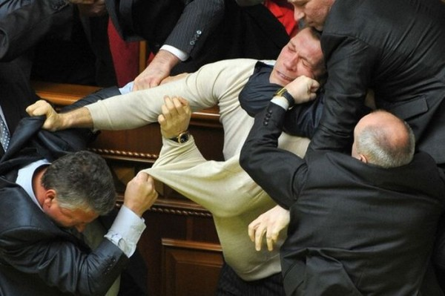
GRC Members...
... discuss
Notes:
bi-weekly teleconferences
reading (existing guidelines, Bylaws and related documents, reviewed guidelines, etc.)
writing (update and write new guidelines and charters)
discussing

Slide 11
Current Process
Review
Write
Discuss
Submit
Adopt
Review
- GRC
- ccNSO Council
- ccNSO Members
Notes:
bi-weekly teleconferences
reading (existing guidelines, Bylaws and related documents, reviewed guidelines, etc.)
writing (update and write new guidelines and charters)
discussing

Slide 12
Improved Process (proposal)
Review
Write
Discuss
Comment
Adopt
Review
Input
- GRC
- ccNSO Council
- ccNSO Members
Notes:
bi-weekly teleconferences
reading (existing guidelines, Bylaws and related documents, reviewed guidelines, etc.)
writing (update and write new guidelines and charters)
discussing

Slide 13
Option 2: Provide Input and Comments

Slide 14
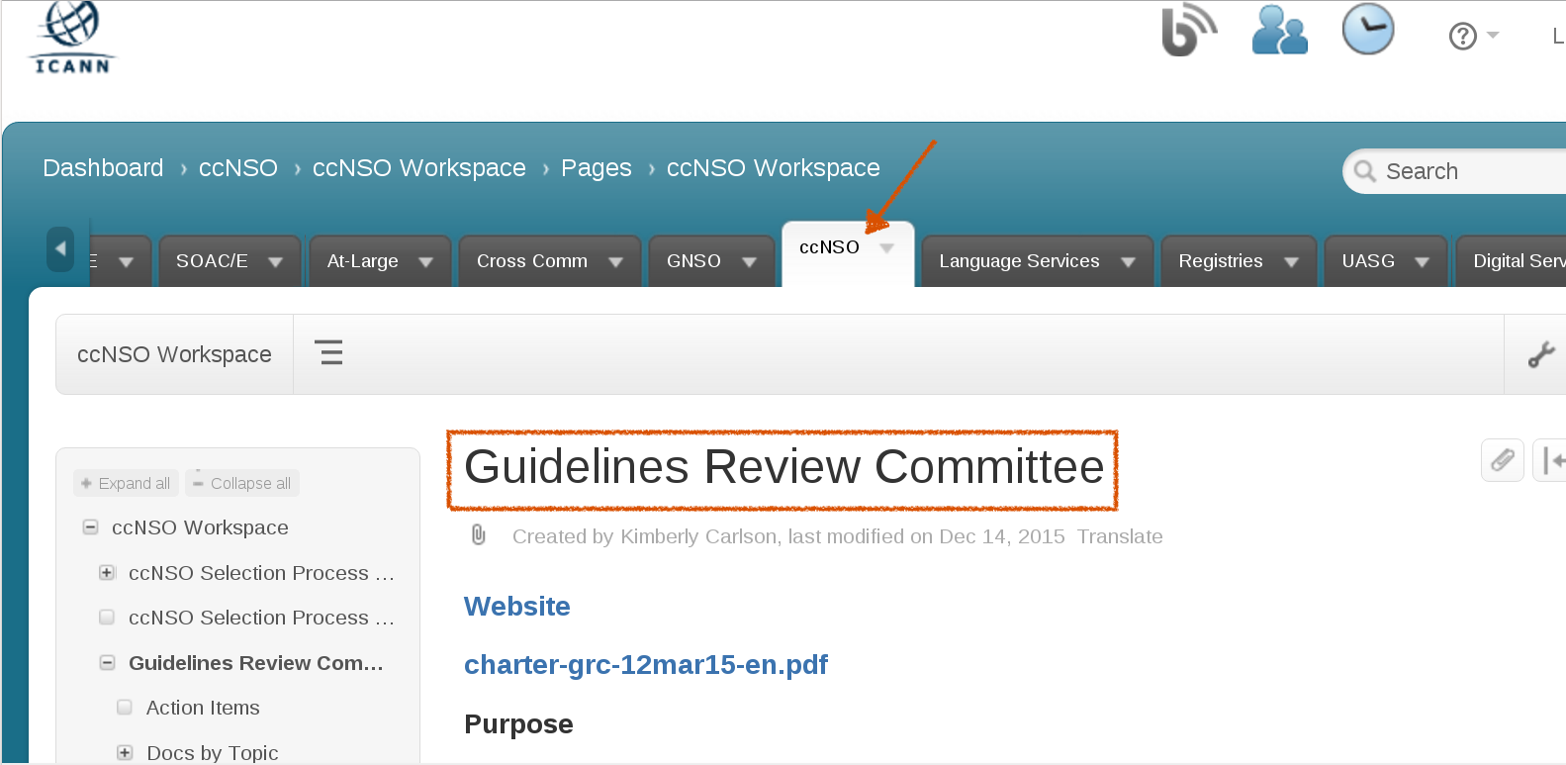
https://community.icann.org/display/ccnsowkspc/Guidelines+Review+Committee
Option 2: Provide Input and Comments

Slide 15
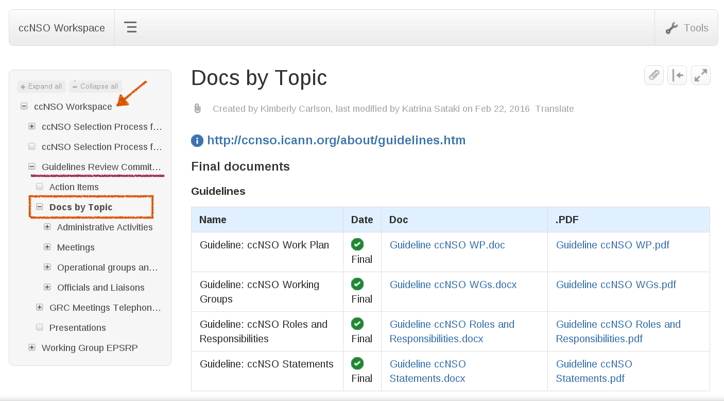
https://community.icann.org/display/ccnsowkspc/Guidelines+Review+Committee

Slide 16
Read! Comment! Participate!

Slide 18
Thank you!

