Slide 1
Registrar view of the ccTLD space
ICANN 57 - ccNSO
Uli Retzlaff

Slide 2
Market Saturation?

Slide 3
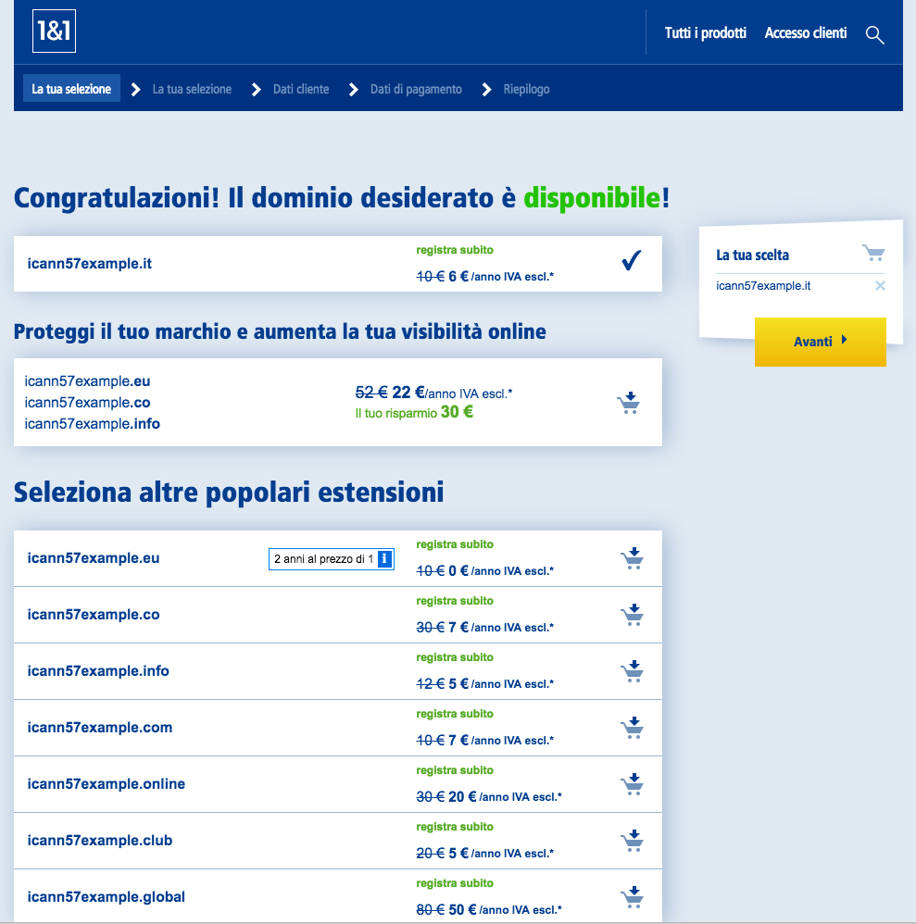
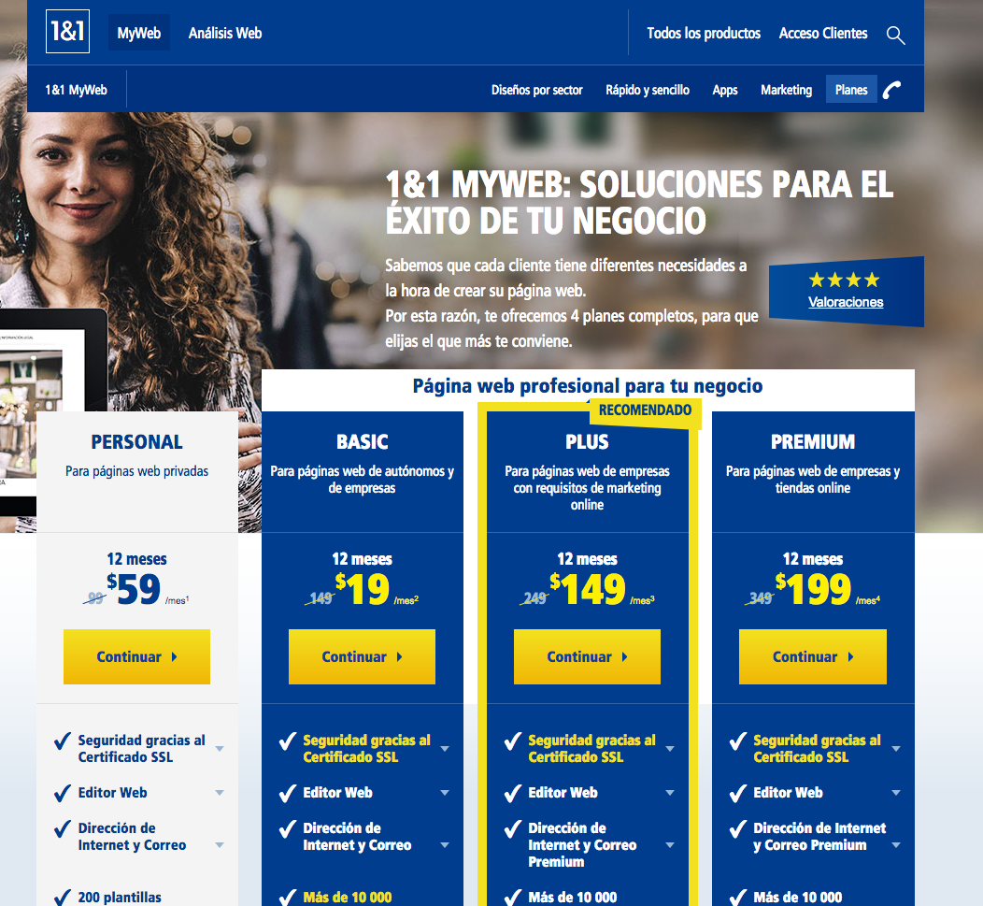
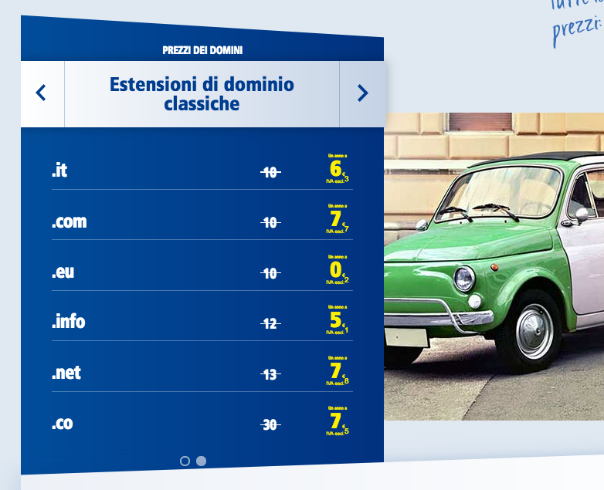
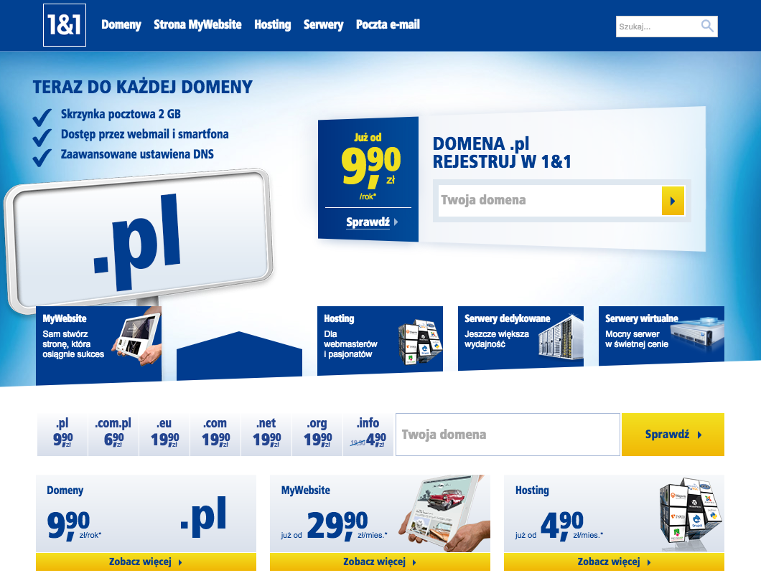
?
Is that all?

Slide 4
Segmentation

Slide 5
Analytics
Product Standardization
Unified Marketing Framework
New usecases for domains
Needs

Slide 6
Thank you.
ICANN 57 - ccNSO
Ulrich.Retzlaff@1und1.de

