Slide 1
Building on the success of a ccTLD to innovate in new markets
Russell Haworth, CEO

Slide 2
The ccTLD challenge
2011 | 2016
Domains bought by customers | Domains sold by registries & registrars
Websites one of the primary ways to have an online identity | Social media and smartphone use ever increasing
Steady growth in domestic markets | Growth strongest in emerging markets
Limited choice of TLDs | Plethora of choice
Limited incumbent competition | Innovative competitors

Slide 3
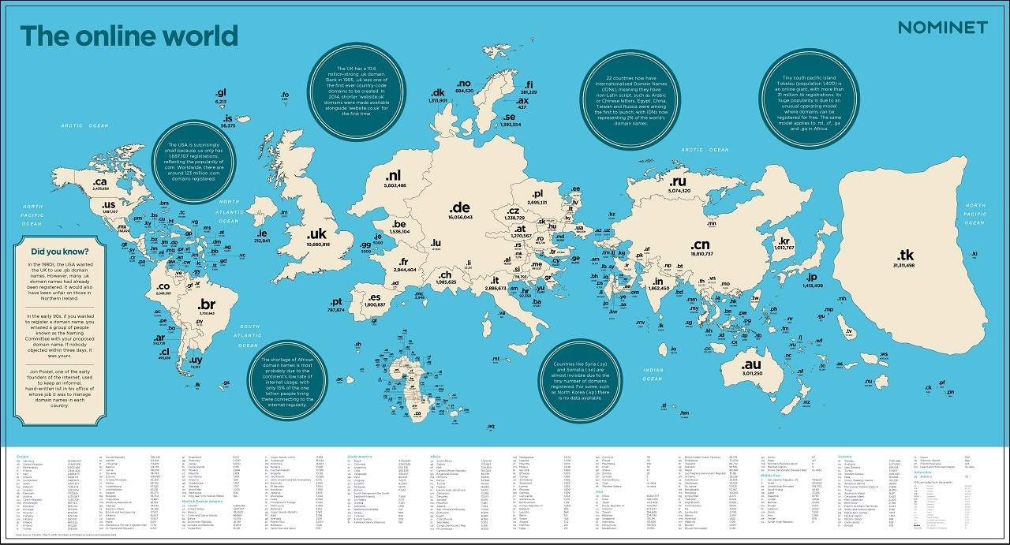
The changing landscape

Slide 4

Our success in running .UK is key
36,000 inbound customer calls
10.6m
600bn DNS queries in last year
1.4m NEW registrations
Respected industry player
Building on the success of a ccTLD to innovate in new markets

Slide 5
Our strategy
Applied Innovation
Registry
Services Provision
Applied Innovation
New capabilities, new markets
High potential, high uncertainty
Challenge: invest in the right areas
Network Analytics
New markets for
existing capabilities
Challenge: compete & differentiate
turing, govt DNS
Brand & gTLDs
RSP
Core
Core
Network Analytics
Nominet ‘owned domains – .UK and .cymru, .wales
Large £; slow growth
Challenge: defend in
competitive market
Small £, high growth
Challenge: succeed in a new market
Notes:
Russell:
a reminder of our strategy…..

Slide 6


Founders complete
Around 1100 registrations
Landrush opened 2nd November
General Availability 21st November

Slide 7

24 SRS Transitions complete
2 transitions scheduled for 8 November
1 new Delegation
Abogado | Dds | Law | Vip | Boston
Bayern | Fashion | Luxe | Vodka | Broadway
Beer | Fishing | London | Wedding | GOP
Budapest | Fit | Miami | Work
Casa | Garden | Rodeo | Yoga
Cooking | Horse | Surf | Bradesco

Slide 8

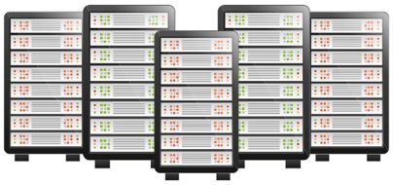







SPAM
MALWARE
DENIAL OF SERVICE
VIRUSES/
TROJANS
UNUSUAL
TRAFFIC PATTERNS
DNS
TUNELLING
SPOOFING/CACHE POISONING
LATENCY ISSUES IDENTIFICATION

Slide 10
Commercial success and our impact on society are inextricably linked
Popular products and services that help more people, or organisations benefit from the internet….
Mean we can invest in initiatives we believe in
Helping build an internet that helps more people, to benefit in more ways, more of the time

Slide 11


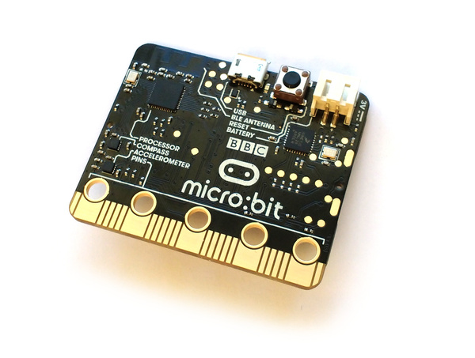
Public Benefit projects – digital engagement
Nominet Propella
Princes’ Trust
Micro:bit
Equipping disadvantaged kids with the skills to help SMEs do more online
Supporting a drive to make the Prince’s Trust more ‘digital’ in how it helps young people
Making the Micro:bit a device for kids to learn about the Internet of Things

Slide 12
Delivering is important because what we do impacts millions of people and businesses
Supporting 3.75m registrants
in 250 countries
Helping registrants and registrars
Processing 600bn DNS responses
per year… for 10m unique requesters, 4.1bn on our busiest day
Using turing to keep .UK, and our customers networks, safe
Notes:
This contribution.

Slide 13


